Slide 1
Information System
Michael Cao

Slide 2
Topic 1: Logic Gate
Michael Cao

Slide 3
Learning Object
In this course, we will focus on the following concept:
Basic logic gate concept
Design of logic gate circuit

Slide 4

What is Logic Gate?
Logic gate is the foundation in computer for everything!

Slide 5
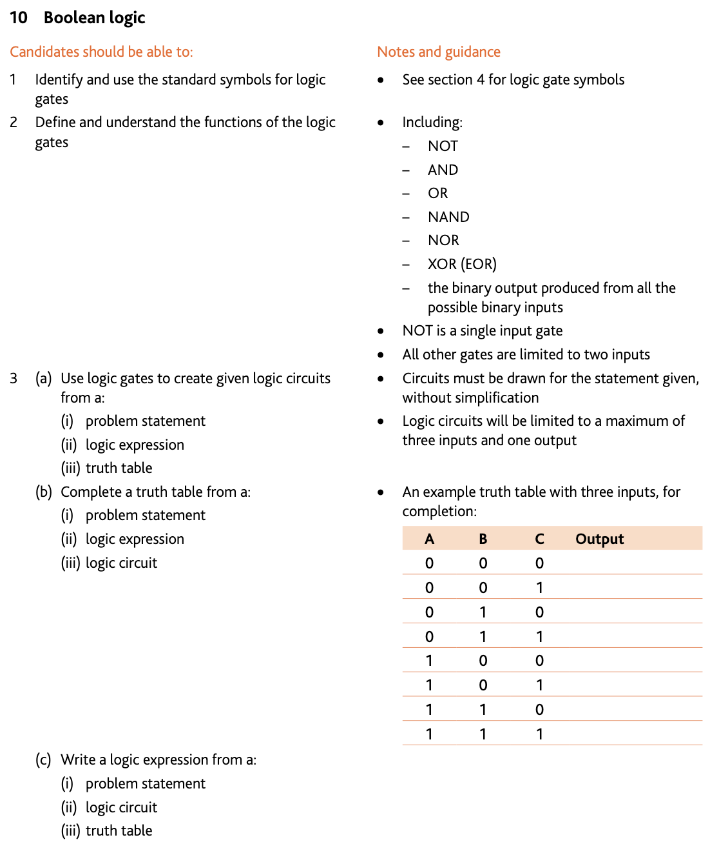
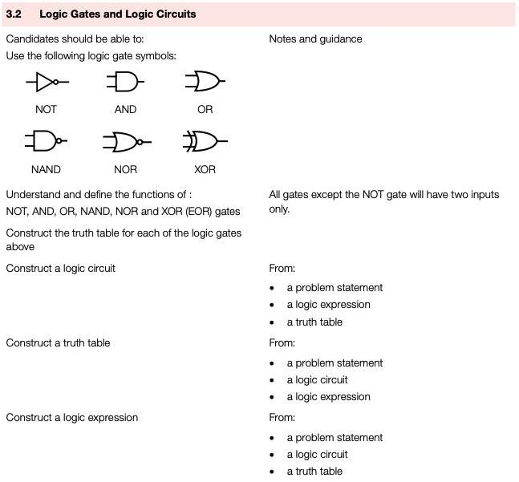
Syllabus of Logic Gate

Slide 6
Points to be Stressed
Please try to answer these questions:
What’s the truth table of XOR gate?
What is ‘problem statement’?
How to conduct a logic expression from a truth table?
Then finish the diagnostic test

Slide 7
Practical Usage of Logic Gate
Based on the video, please think of the questions:
Why we use logic gate?
What kind of problem can logic circuit solve?
What will be the truth table of 1 bit adder? And logic circuit?
What about considering the carry bit?
What will be the design of 8-bit adder using logic circuit?
Any other function of circuit you can build? Use online simulator !

Slide 8
Topic 2: Number System
Michael Cao

Slide 9
Learning Object
In this course, we will focus on the following concept:
Number system
Two’s complement
BCD code
ASCII code and Unicode

Slide 10
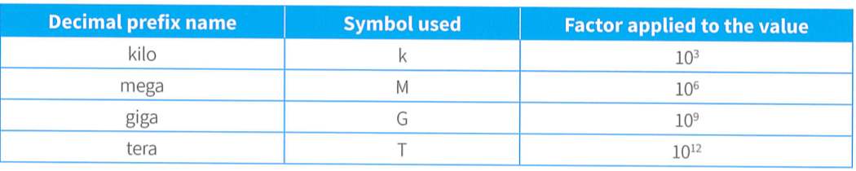
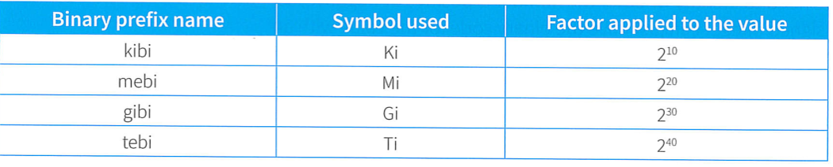
Number System
Binary number is the foundation in computer science:
Binary is used because switches only have ‘on’ and ‘off’ states
Hexadecimal is used because it’s easier for human to read
The key of transformation is to focus on the weight
Special attention for the definition of ‘prefix’
Activity: explore the definition of positional and un-positional number system

Slide 11

Two’s Complement
We use two’s complement for calculation:
If we use original number, there will cause error
Multiple ways to calculate the two’s complement
The philosophy is to find a number that have the same result with carry or overflow
-128 – 127 is the range of two’s complement
Explore how to transfer a negative two’s complement to denary number directly
Practice for deriving the two’s complement, as well as addition calculation

Slide 12
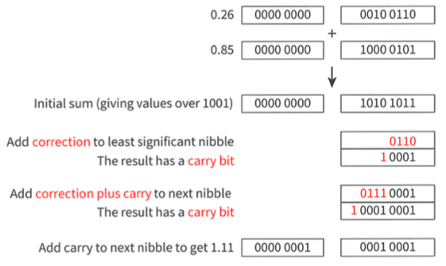
BCD Code
BCD stands for Binary Coded Decimal:
Useful in applications that require single denary digits be used
BCD represents one denary digit in a nibble
If over than 9, then plus 6 (0110)
Challenge: Use python to create a BCD adder, the input is 2 positive number, convert each digit to binary, use BCD rules to add, then output denary result

Slide 13
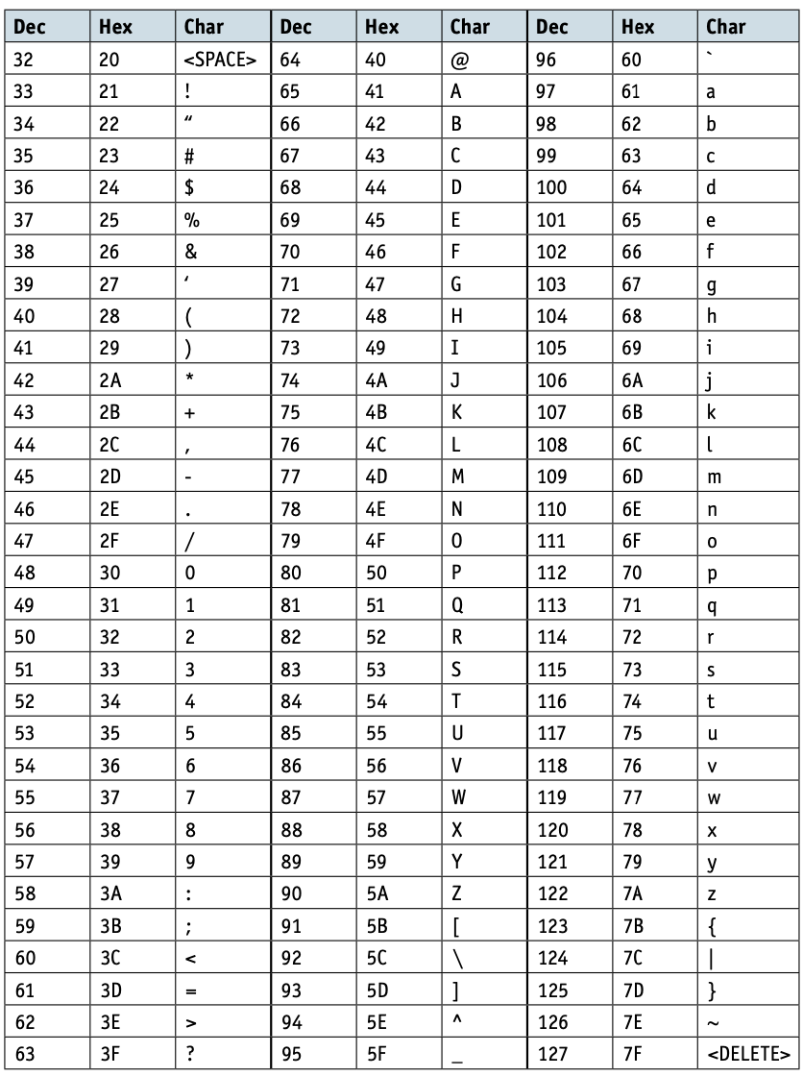
ASCII and Unicode
We need a coding scheme to store text in a computer:
ASCII: American Standard Code for Information Interchange
No need to remember each code, but know the rules
Limited characters with 1 byte length (Extended)
Unicode: Cover more characters with 2 bytes

Slide 14
Topic 3: Media and Compression
Michael Cao

Slide 15
Learning Object
In this course, we will focus on the following concept:
Bitmap and vector graphic
Sound
Compression technique

Slide 16

Bitmap
Bitmap is generally used to store an image:
Pixel: the smallest component of bitmap. (essential information?)
Color depth: the number of bits used to represent one pixel
Bit depth: the number of bits used to represent each channel
Resolution: image resolution and screen resolution
File Header: a set of bytes at the beginning identifies the files and contains information about the coding used

Slide 17
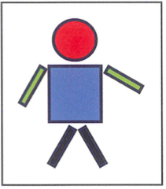

Vector Graphic
Vector graphic is usually created by human:
Drawing Object: a component defined by geometric formulae and associated properties
Drawing List: the list of shapes involved in an image // a list that stores the command/description required to draw each object
Property: Define one aspect of the appearance of the drawing object

Slide 18
Activity
Please make a comparison between vector graphic and bitmap from:
Where it come from? Easy to create?
What’s the basic component?
What’s the feature?
Occupation of space?
Realistic? Vivid?
The best use situation?
ETC.

Slide 19
Sound
Sound is a continuous format of media:
ADC and DAC: convert between analogue and digital data
Sampling: taking measurements at regular intervals and storing the values
Sampling resolution: the number of bits used to store each sample
Sampling rate: the number of samples taken per second
Calculate the file size of images, sound files and videos

Slide 20
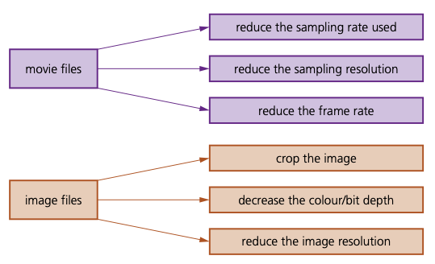
Compression
Compression is useful to reduce file size:
File Size: Calculated by unit and quantity. (also the logic of compression)
Lossless compression: original file can be restored
Coding map table (use code.org to explore)
Run-length encoding (consecutive repeating patterns)
Lossy compression: some data is lost permanently
Perceptual shaping
Crop or reduce resolution of depth
Relative mapping (adjacent frames in video)
Challenge: Write python code to implement RLE
Presentation: design / introduce a compression method by your own
Hint: Introduction can include from thesis or existed compression format

